Slide 1

NAVIGATING THROUGH YASH’S FINANCIAL BLUEPRINT
AN ECONOMIC DECISION-MAKING EXPLORATION UNDER THE GUIDANCE OF:
DR. MANISH RANJIT
Vidit Vinay Jain | Yash Sanjay Bagul | Amrutha Varshini |
Vatsal Hitendra Shah | Aman Ajay Malawade | Sajitha Banu Raja Mohamed

Slide 2

LET’S GET TO KNOW YASH
Yash, a 24-year-old engineer, aims to retire comfortably at 60. He seeks a financial plan to secure his future, covering housing, transportation, education loans, and investments.
Let's craft a 36-year plan to guide him towards his retirement goals
Team 01
01

Slide 3
YASH’S FINANCIAL BACKGROUND
1
Loans Undertaken:
2
Job Details:
3
Retirement:
Loan Amount: $70,000
Disbursed Amount for First Year Fees: $35,000
Disbursed Amount for Final Year Fees: $35,000
Interest Rate: 2% per year compounded monthly
Starting Salary: $8,000 per month (increases by 5% every 12 months)
Signing Bonus: $10,000
Salary Deduction for Retirement Fund: 6% of monthly salary
Tax on Salary: Will vary as per the income tax bracket.
Retirement Age: 60
Monthly Contribution to Retirement Fund: 6% of monthly salary
Team 01
02

Slide 4
YASH’S PLAN FOR INVESTMENTS
AGE 24
AGE 30
AGE 40
AGE 50
AGE 60
GRADUATION
+
FIRST JOB
FIRST CAR
SECOND CAR
+
FIRST HOUSE
THIRD CAR
RETIREMENT
Team 01
03

Slide 5






FACTORS CAUSING YASH’S DILEMMA
TRANSPORTATION
ACCOMODATION
INVESTMENTS
Team 01
04

Slide 6

YASH’S TRANSPORTATION PLAN
Yash Buys his first New Car at age of 30
Yash will be using Public Transport for the first 6 Years
Honda Civic LX Sedan (First Car-Age 30):
Total Cost: $23,950
Down payment: $6000
Loan Amount & Period: $17950 and 5 years.
Interest: 6%/year/monthly
Monthly Payment: $347.02
Monthly O&M: $150 and increases by $3 every month
Resale Value: $7000.
Public Transportation:
Monthly LinkPass Cost in MA: $90
Potential Savings from Public Transit in Boston, MA: $1,310 per month or $15,714 per year
Team 01
05

Slide 7
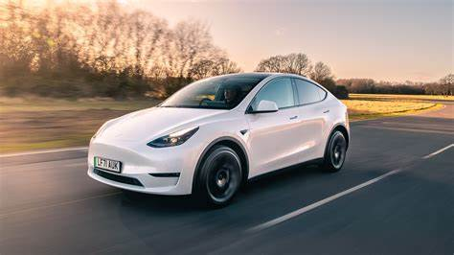
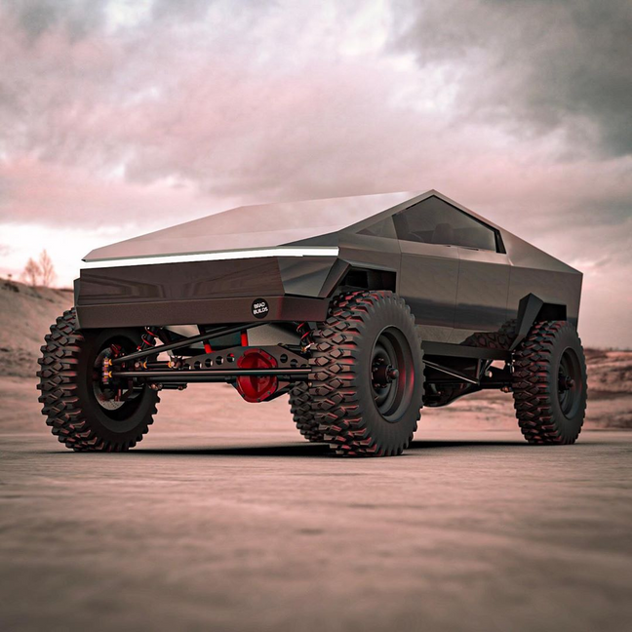
YASH’S TRANSPORTATION plan
Yash buys second car at age of 40
Yash buys third car at age of 50
Tesla Model Y Rear-Wheel Drive
Total Cost: $40,310
Down payment: $10000
Loan Amount & Period: $30,310 and 5 years.
Interest: 5%/year/monthly
Monthly Payment: $571.99
Monthly O&M: $100 and increases by $2 every month
Resale Value: $12000.
Tesla Cybertruck Rear- Wheel Drive
Total Cost: $57,390
Down payment: $14000
Loan Amount & Period: $43,390 and 5 years.
Interest: 5%/year/monthly
Monthly Payment: $818.82
Monthly O&M: $100 and increases by $2 every month
Resale Value: $18000.
Team 01
06

Slide 8
YASH’S HOUSING plan
Renting an Apartment
Buying a House
Yash will be living in a rental apartment for first 16 years
Yash buys his own house at age of 40
Rents apartment till age of 40
Starting Rent - $1500/month
Rent increases by 6% annually.
Cost of House: $500,000
Down Payment: $100,000
Loan Amount: $400,000
Loan Period: 15 years
Interest Rate: 5% per year
Monthly Mortgage Payment: $3163.17
Team 01
07

Slide 9
YASH’S INVESTMENT plan
Investment in Mutual Funds:
Without Investment in Mutual Funds:
Contribution to High Yield Savings Account
Considering Yash doesn’t invest in Mutual funds and invest the similar amount in High Yield Savings account.
Total Savings = Salary - All Spendings
Anticipated Returns:
The interest for the savings account will depend on MARR considerations.
Monthly Contribution:
He puts aside 5% of his monthly salary into Mutual Funds
Anticipated returns from Mutual Funds:
8%/year/monthly(Assuming sold at end of planning horizon)
MARR Considerations: 1%, 5%, 7%, 15%, 20%, 30%, 35%, 40%
Team 01
08

Slide 10
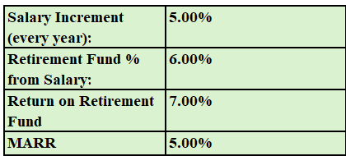
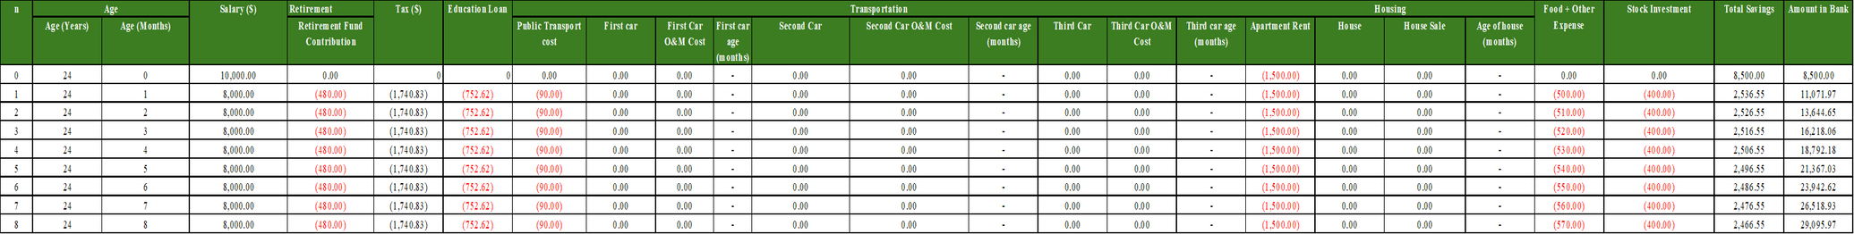
CALCULATIONS - (FOR CASE 1)
NPW | $1,622,968.74
FW | $9,781,740.31
We have considered 12 investment cases and prepared 12 identical sheets to show calculations for each case
Different MARR values as 1%, 5%, 7%, 15%, 20%, 30%, 35%, 40% were taken into account.
Team 01
09

Slide 11
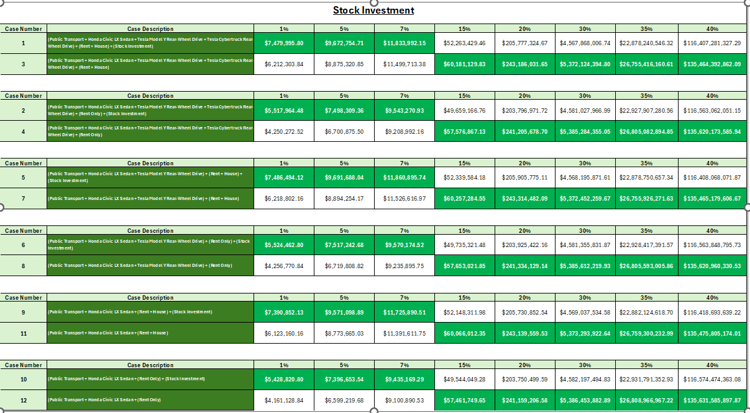
PAIR COMPARISION- STOCK INVESTMENT
Team 01
10

Slide 12
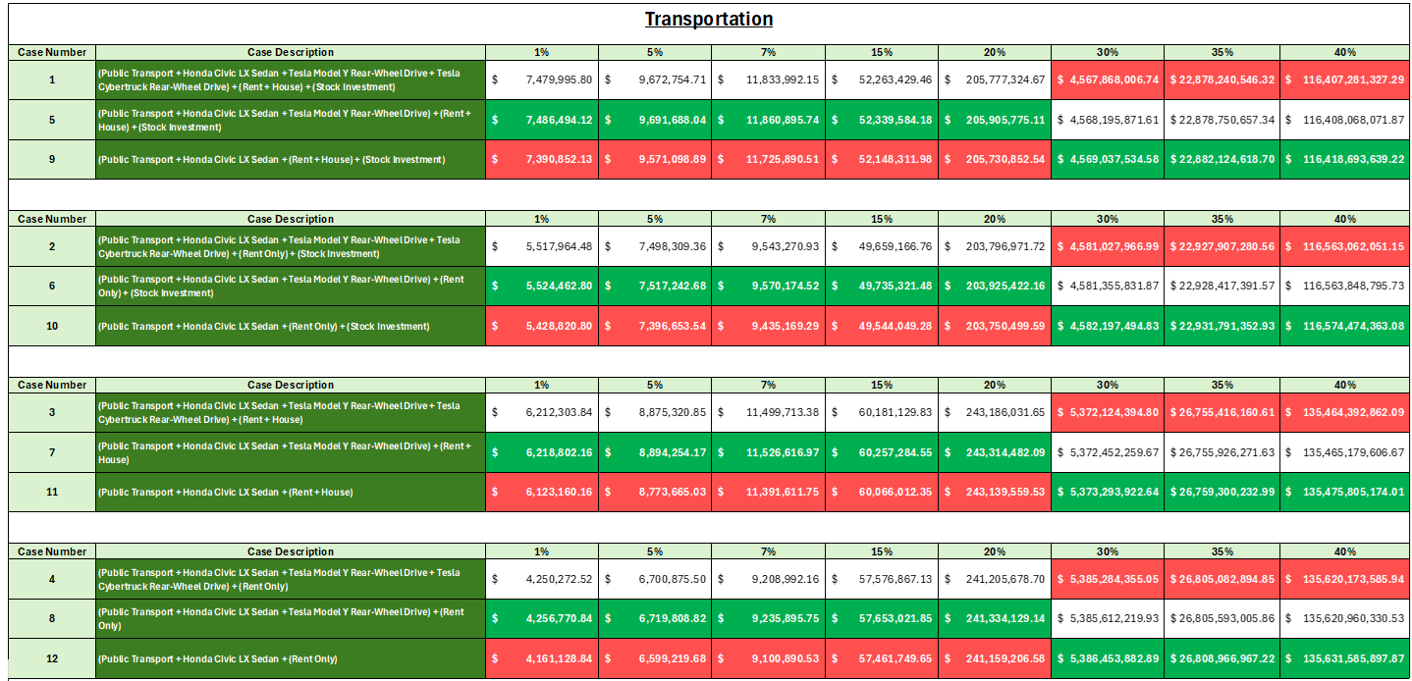
PAIR COMPARISION- TRANSPORTATION
Team 01
11

Slide 13
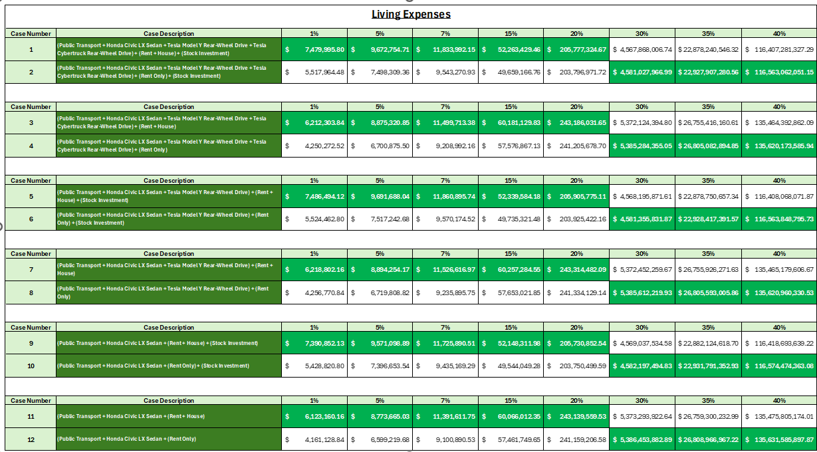
PAIR COMPARISION- LIVING EXPENSES
Team 01
12

Slide 14
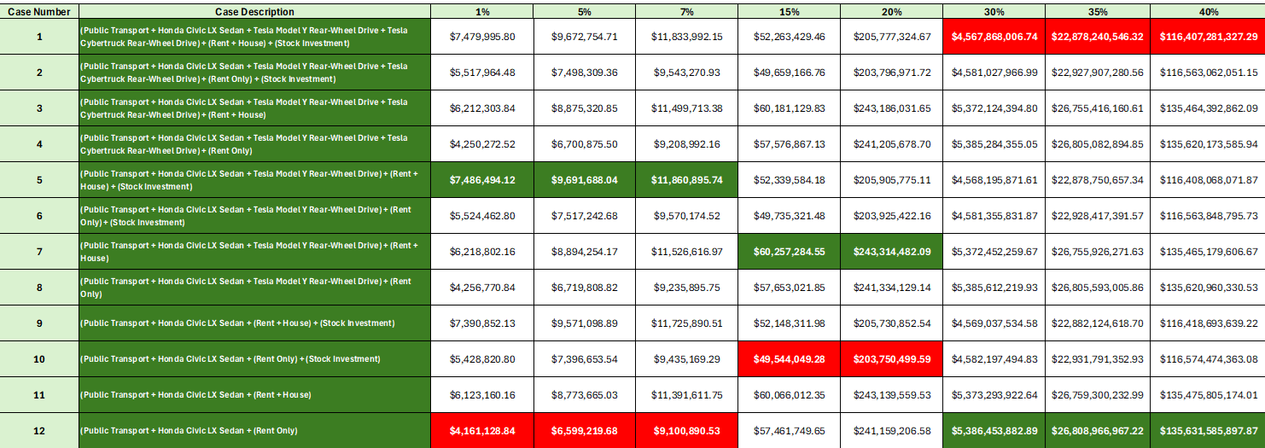
CASE WISE FUTURE WORTH ANALYSIS
The values highlighted in green shows the case with highest future worth for given MARR.
The values highlighted in red shows the case with lowest fututre worth for given MARR.
Team 01
13

Slide 15
CONCLUSION
Based on the Future Worth Analysis, We have identified the cases which provide optimal Future Worth at different MARR.
For MARR of 1%, 5%, 7% Case 5 provides the highest Future Worth, whereas Case 12 provides lowest future worth.
For MARR of 15%, 20% Case 7 provides the highest future worth, whereas case 10 provides lowest future worth.
For MARR 30%, 35%, 40% Case 12 provides highest Future worth, whereas Case 1 provides lowest future worth.
Team 01
14

Slide 16
REFERENCES
https://www.bankrate.com/loans/student-loans/current-interest-rates/#best-rates
https://www.cargurus.com https://www.investopedia.com/articles/investing/090314/just-what-factors-value-your-used-car.asp
https://www.carfax.com/press/resources/car-values-infographic
Team 01
15

Slide 17
TEAM 01
THANK
YOU!
Vidit Vinay Jain
Yash Sanjay Bagul
S Amrutha Varshini
Vatsal Hitendra Shah
Aman Ajay Malawade
Sajitha Banu Raja Mohamed

